Slide 1
STED Sample Prep
Sample Mounting

Slide 2
Points to keep in mind:
#1.5 coverslips ONLY!
DAPI free mounting media
Refractive index matched mounting media
STED 100x Oil (oil=1.518)
New Glyc Obj good for cleared tissue at approx. 1.47
Water STED objective for Live Cell Imaging
Acid-washed coverslips are preferable to flamed coverslips
Avoid “sealants” that can quench fluorescence or create autofluorescence (i.e. color nailpolish)

Slide 3
Objective Lens for Deep & Live Cell Nanoscopy
HC PL APO 93x/1.3 Glyc motCORR STED_{white}
Free working distance: 0.3 mm
motCORR for easy handling
  Coverglas: 0.14 – 0.19
  „RI-range“: 1.441 – 1.468¹
NA: 1.3
Magnification: 93 x
FOV @ Zoom 0.75 : 167 µm
Temperature: 23°& 37°C
¹ RI at 546 nm and coverslip 0,17mm
Notes:
Component # 2 – superior optics
Briefly explain what white stands for – excellent color correction in the range between 440 – 800 nm

Slide 4
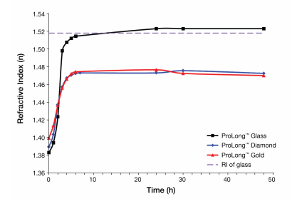
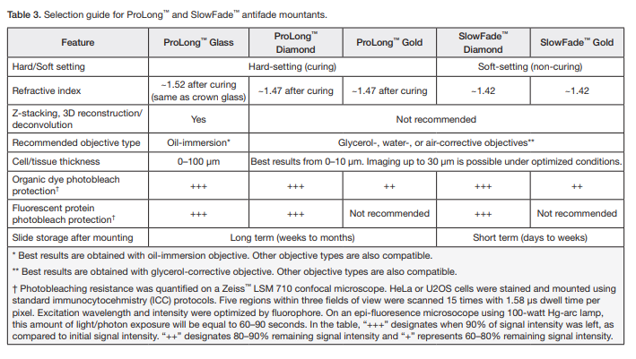
Mounting Media
The curing time for 1–2 drops (40–80 μL) of mountant on cultured cells or tissue sections of less than 10 μm under a coverslip is 12–24 hours. Tissue sections thicker than 10 μm take more time to cure and require 24–48 hours. Humidity level in the air and/or the temperature during curing or analysis can also effect the RI of the sample.

Slide 5
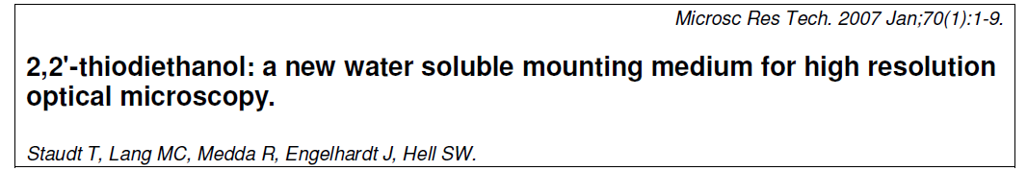
Mounting Media
With thick tissue sections - fixed
  Thiodiethanol (TDE, Sigma, #88559) mixed with an anti-fade reagent has been used with good results, especially for deep imaging.
    The TDE concentration must be gradually enhanced (up to 97%) to obtain a final refractive index of 1.514
    Sequential steps in TDE 50%, 70% (15-30 minutes at each step), then in 97% + antifade as final mounting media must be undertaken.
    The coverslip must be sealed using invisible nail polish or other sealants.
    Be sure that the sealant is not quenching your fluorescence or creating any autofluorescence.

Slide 6
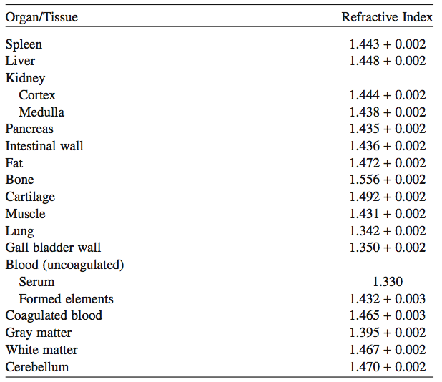
Refractive indices of tissue and organs
Tissue is a composite of biomolecules
with different RIs:
Protein: ~ 1,43
Lipids: ~ 1,44
Water: ~ 1,33
collectively constitute the overall
Tissue RI: ~ 1,4 – 1,5
Seo J., Choe M., Kim S.Y.. Mol. Cells 39 (6) (2016)
Pawley (Ed.), Handbook of biological confocal microscopy, 3rd edition, Chapter 18
Notes:
Additionally: many frequently used mounting media for fixed samples are glycerol-based and hence have an RI close to that of glycerol

Slide 7
Choosing fluorescent dyes for STED

Slide 8
Recommended Single Dyes
Single color for 592 nm depletion
  DyLight 488 or 514
  Oregon Green 488 or 514
  AlexaFluor 488 or 514
  ATTO 488 or 514
Single color for 660 nm depletion
  Alexa 532
  ATTO 532 or 550
  TMR/TRITC
  Alexa 555
Single color for 775 nm depletion
  ATTO 647N or Alexa 647
  Alexa 633
  Alexa & Atto 594
  Star 635*

Slide 9
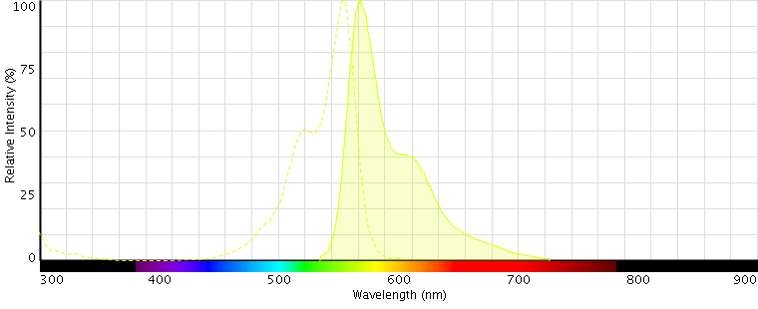
Single color STED
For STED to work efficiently, the emission spectra needs to show emission at the STED wavelength.
No excitation at the depletion wavelength.
Ex: Alexa 555 for the 660 nm depletion laser →
Excitation @
555 nm
Depletion @
660 nm

Slide 10
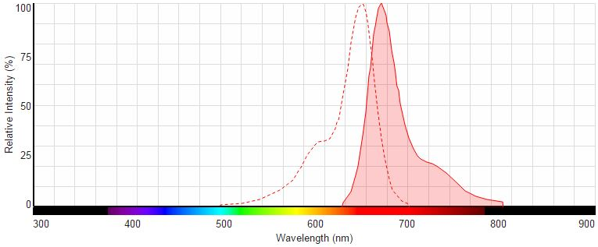
Single color STED
For STED to work efficiently, the emission spectra needs to show significant emission at the STED wavelength.
No excitation at the depletion wavelength.
Ex: Alexa 647 for the 775 nm depletion laser →
Excitation @
647 nm
Depletion @
775 nm

Slide 11
Sample Preparation Considerations
Dual and Triple Color STED microscopy
Notes:
Important information

Slide 12
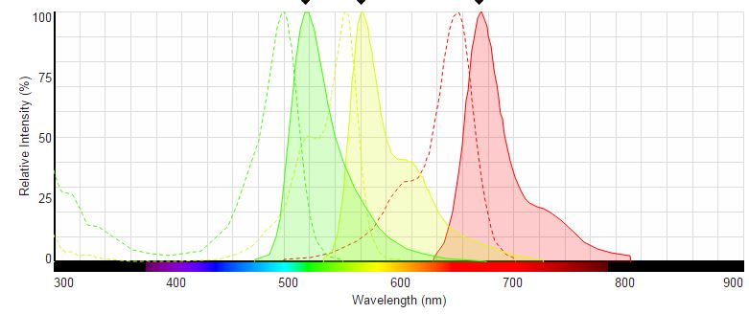
Multi-color STED
For STED to work efficiently, the emission spectra of both dyes need to show significant emission at the STED laser wavelengths.
Ex: Alexa 647, Alexa 555 and OG 488 for the 775 nm, 660 nm and 592 nm depletion laser →
Sequential scan 1:
Excitation @
647 nm
Depletion @
775 nm
** Rule: “Image red → blue” ALWAYS start your sequential 660/592 nm STED scans with the LONGER WAVELENGTH dye and the 660 nm depletion laser!!! The 592 nm depletion laser may bleach orange/red dyes.

Slide 13
Multi-color STED
For STED to work efficiently, the emission spectra of both dyes need to show significant emission at the STED laser wavelengths.
Ex: Alexa 647, Alexa 555 and OG 488 for the 775 nm, 660 nm and 592 nm depletion laser →
Sequential scan 2:
Excitation @
555 nm
Depletion @
660 nm
** Rule: “Image red → blue” ALWAYS start your sequential 660/592 nm STED scans with the LONGER WAVELENGTH dye and the 660 nm depletion laser!!! The 592 nm depletion laser may bleach orange/red dyes.

Slide 14
Multi-color STED
For STED to work efficiently, the emission spectra of both dyes need to show significant emission at the STED laser wavelengths.
Ex: Alexa 647, Alexa 555 and OG 488 for the 775 nm, 660 nm and 592 nm depletion laser →
Sequential scan 3:
Excitation @
470 nm
Depletion @
592 nm
** Rule: “Image red → blue” ALWAYS start your sequential 660/592 nm STED scans with the LONGER WAVELENGTH dye and the 660 nm depletion laser!!! The 592 nm depletion laser may bleach orange/red dyes.

Slide 15
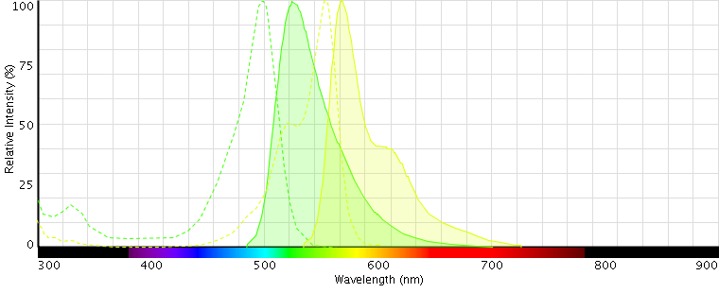
Multi-color STED – 1 STED laser
For STED to work efficiently, the emission spectra of both dyes need to show significant emission at the STED laser wavelengths.
Ex: Alexa 555 and OG 488 for the 660 nm depletion laser →
Excitation @
470 nm
Excitation @
555 nm
Depletion @
660 nm
** Dyes with similar emission spectra to OG488 will show resolution improvement with the 660nm laser, but the optimal super-resolution will be obtained with the 592nm laser.

Slide 16
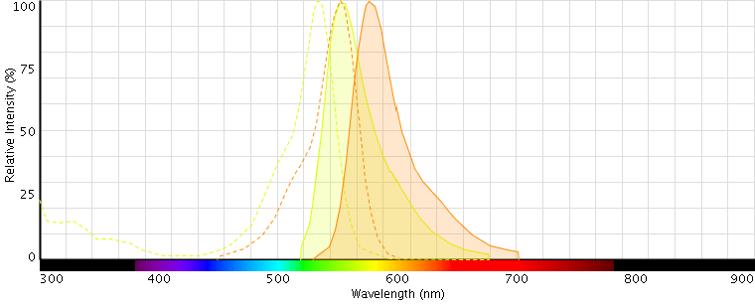
Multi-color STED – 1 STED laser
For STED to work efficiently, the emission spectra of both dyes need to show significant emission at the STED laser wavelengths.
Ex: Alexa 532 and TMR for the 660 nm depletion laser →
Excitation @
514 nm
Excitation @
580 nm
Depletion @
660 nm

Slide 17
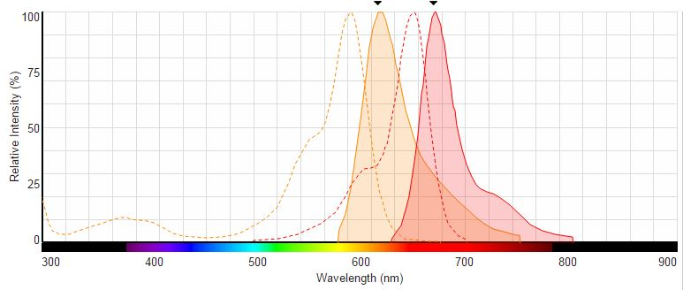
Multi-color STED – 1 STED laser
For STED to work efficiently, the emission spectra of both dyes need to show significant emission at the STED laser wavelengths.
Ex: Alexa 594 and Atto 647N for the 775 nm depletion laser →
Excitation @
580 nm
Excitation @
660 nm
Depletion @
775 nm

Slide 18
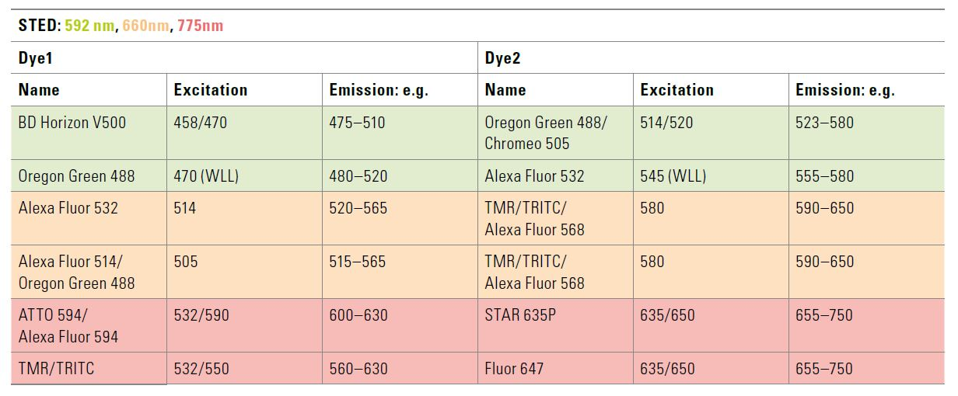
STED 3X Multi-Color Combinations
Examples of dual color acquisition for selected dyes pairs, and spectra:
Leica Microsystems 2014

Slide 19
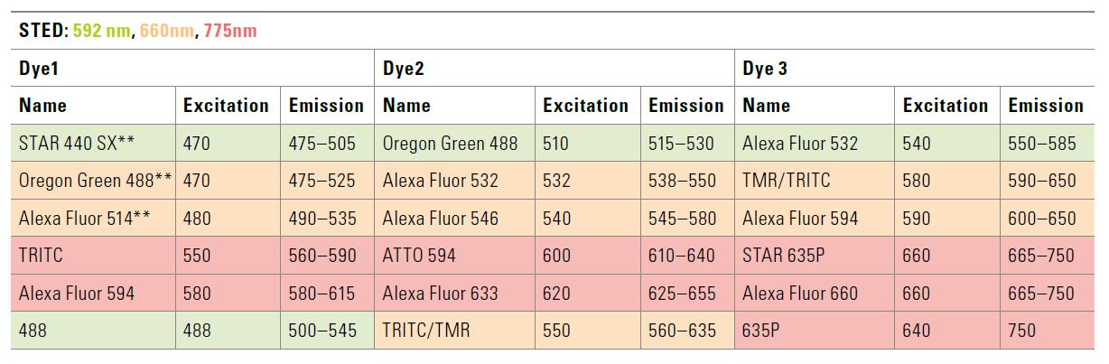
STED 3X Multi-Color Combinations
Examples of triple color acquisition for selected dyes pairs, and spectra:
Leica Microsystems 2014

Slide 20
Live Cell Imaging - Fluorescent Proteins
Fluorecent Protein | Excitation (nm) | Depletion (nm) | Performance^{1,2}
mTurquoise2 | 434 | 592 | Very good
mTFP1 | 462 | 592 | Excellent
eGFP | 484 | 592 | Very good
EmGFP | 487 | 592 | Very good
mNeonGreen | 506 | 592 660 | Excellent Moderate
eYFP | 514 | 592 660 | Excellent Moderate
Venus | 515 | 592 660 | Excellent Moderate
mCitrine | 516 | 592 660 | Excellent Moderate
DsRed/mRFP | 558 | 660 | Very good
mStrawberry | 574 | 660 | Very good
mCherry | 587 | 775 | Moderate
iRFP | 690 | 775 | Moderate
¹ the increase in resolution by STED for a given fluorophore depends on the STED wavelength used, less resolution improvement with
longer STED wavelength
² rating based personal experience, may not reflect all experimental situations

Slide 21
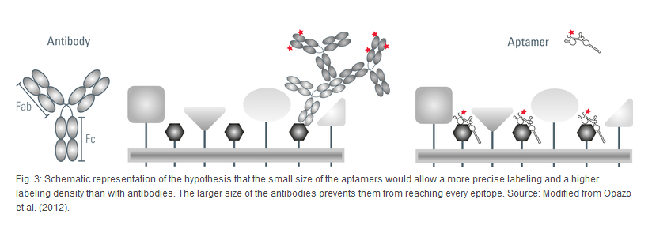
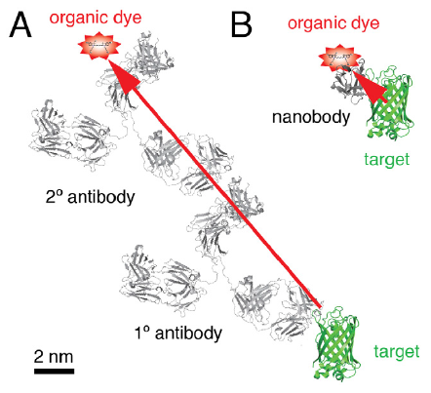
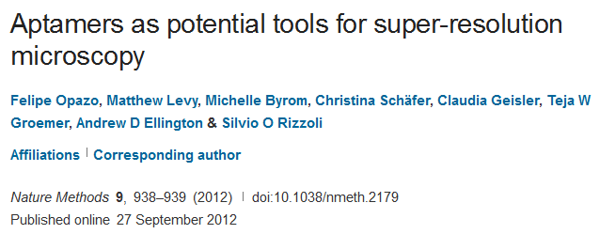
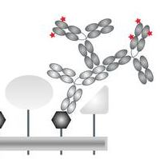
New labeling tools
Antibody | Fab fragments | Nanobodies (sdAb fragments) | Aptamer
150 - 160 kDa | 25 - 100 kDa F(ab)2, Fab, scFv | 12 - 15 kDa | 10 – 15 kDa (Nucleic Acid or Peptide ~)
~ 10 nm | 5 - 7 nm | 2 – 3 nm | 3 – 5 nm
fixed samples | fixed samples | fixed samples | live cell imaging
Nanobodies for high-resolution imaging
J. Phys. D: Appl. Phys. 48 (2015) Helge Ewers
Notes:
Antibody: 150kDa, 10-15nm length; + secondary antibody 20 – 40 nm length
Fab Fragments – antibody fragment, slightly more expensive than
Aptamers: new labeling probes for STED, small ssDNA / ssRNA oligonucleotides (15 -100 nucleotides), Peptid-Aptamer assume a specific tertiary structure with binding affinity to other proteins;development costs: 2000 – 4000€; specificity takes time and money; (Opazo et al. 2012); live imaging possible; easy uptake of cell; Silvio Rizzoli group
Nanobodies: source camels, Chondrichthyes single chain antibodies, costs 8000 -10000€, good for fixed samples

Slide 22
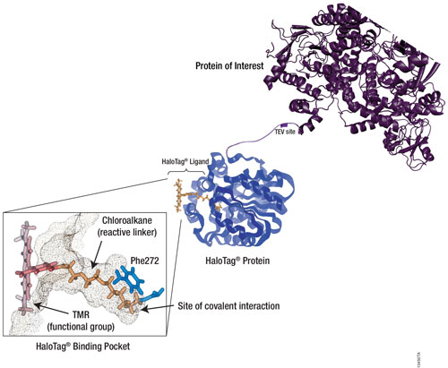
Live Cell Strategies – HaloTag® (Promega)
HaloTag technology uses vectors to tag a protein of interest, leading to constitutive expression of the HaloTag
A HaloTag Ligand specific for the HaloTag Protein contains a reactive linker and a fluorescent dye
Readily available dyes compatible with STED:
  OG488
  AF488
  diAcFAM
  TMR
  AF660
Promega will work with you to create custom tags with fluorophore of choice

Slide 23
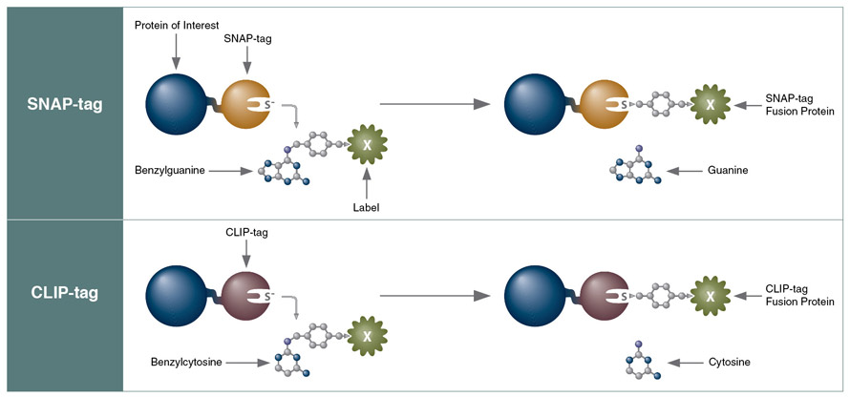
Live Cell Strategies – SNAP-Tag® (NEB, Inc)
SNAP-Tags are based on hAGT, a DNA repair protein; expressed as a SNAP-tag fusion with protein of interest
SNAP-Tags react with benzylguanine derivatives
  The fluorophore is conjugated to guanine with a benzyl linker
  Binding of the fluorophore to the SNAP-tag is irreversible
Comes in two variations: SNAP-Tag Surface and SNAP-Tag Cell
Readily available conjugated fluorophores:
  360, 430, OG488, Fluorescein, 505, TMR, AF594, 647-SiR
Custom conjugated fluorophores can be made by NEB
  Very helpful support!

Slide 24
Live Cell Strategies – CLIP-Tag® (NEB, Inc)
CLIP-Tags are similar to SNAP-Tags, expresses the protein of interest as a CLIP-tag fusion
CLIP-Tags react with benzylcytosine derivatives
  The fluorophore is conjugated to cytosine with a benzyl linker
  Binding of the fluorophore to the CLIP-tag is irreversible
Comes in two variations: CLIP-Tag Surface and CLIP-Tag Cell
Readily available conjugated fluorophores:
  488, 505, 547, 647
Custom conjugated fluorophores can be made by NEB
When used with SNAP-Tags, you can have multi-color live imaging!

Slide 25
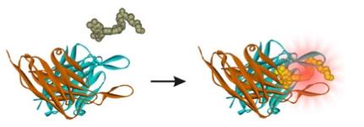
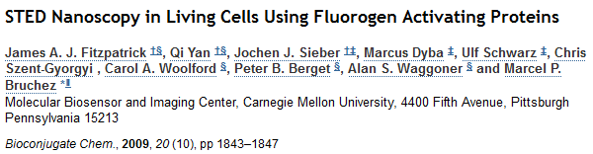
Live Cell Strategies – Fluorogen Activated Protein (Sharp Edge Labs)
FAP-fusions can be created that behave similarly to GFP-tagged proteins
Target the FAP by creating fusion proteins (targeting)
Modulate the properties of the Fluorogenes (sensing)

Slide 26
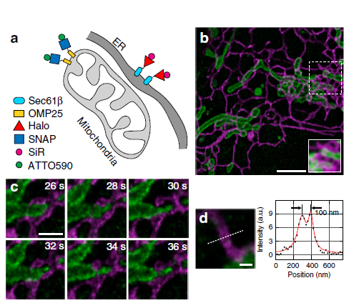
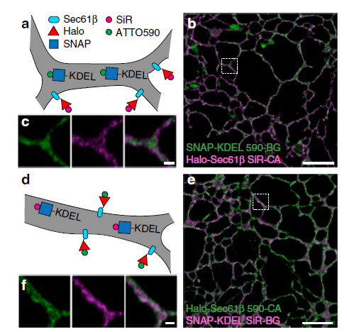
Live Cell Strategies – Bewersdorf Lab
STED nanoscopy of dynamic interactions between ER and mitochondria
Two-colour STED nanoscopy of the ER
Two-colour live-cell nanoscale imaging of intracellular targets, Francesca Bottanelli, Joerg Bewersdorf et al., Nature Communications 7:10778, DOI: 10.1038/ncomms10778
Notes:
Custom-built STED nanoscope. As shown in Supplementary Fig. 1, an 80-MHz pulsed depletion laser with a pulse length of ~600 ps (775 nm, Katana, OneFive) is coupled into a 100-m long polarization maintaining single-mode fibre (PM-SMF) (PM630-HP, Thorlabs). The beam emerging from the fibre is collimated and illuminates a spatial light modulator (X10468-02, Hamamatsu), which applies a helical phase ramp to the depletion beam and enables aberration correction within the depletion laser beam path. The spatial light modulator is imaged onto a 16-kHz resonance mirror (SC-30, EOPC), which, in turn, is imaged into the pupil of a 100 oil immersion objective lens (UPLSAPO 100XO PSF, Olympus), mounted in an inverted microscope stand (IX71, Olympus). Three pulsed excitation lasers (485 nm, LDH-P-C-485B, PicoQuant; 650 nm, LDH-D-C-650, PicoQuant; 594 nm, LightUp594,
SNAP: Benzylguanine (BG)
HaloTag: Chloroalkane (CA)

Slide 27
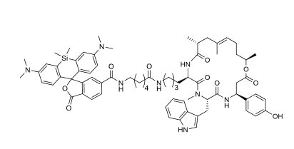
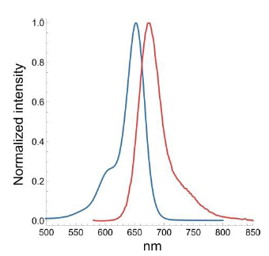

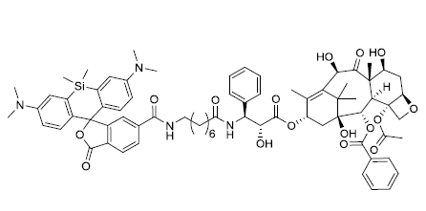
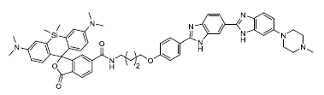
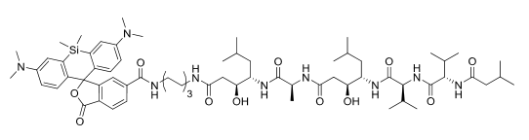
Live-Cell Imaging - SiR dyes
Jasplakinolide -> F-actin
Docetaxel -> microtubules
Bisbenzimide (Hoechst) -> DNA
Pepstatin A-> Lysosomes

Slide 28
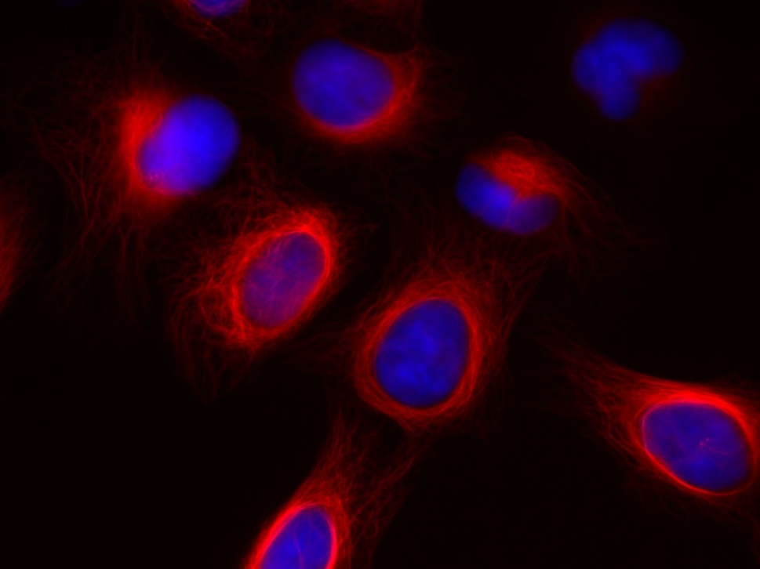
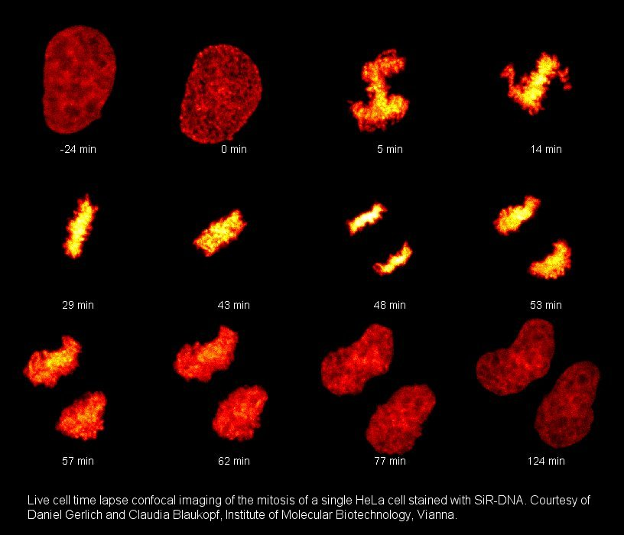
Living Cell Strategies – Other Probes
Other probes
  Tubulin Tracker Green 488 / 514 592
  BABTA 488 / 514 592
  Lifeact (Actin marker) 488 / 514 (483 / 506) 592
  SiR Actin/Tubulin 652 / 674 775
  SiR-DNA 652/674 775
Spirochrome
Spirochrome
Leica Microsystems 2014

Slide 29
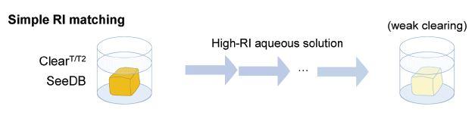
Optical Clearing Techniques
Simple Refractive Index Matching
1.
Weak to moderate clearing capacity, modestl transparency
limited penetration of probes into processed tissue
Seo J., Choe M., Kim S.Y.. Mol. Cells 39 (6) (2016)
Notes:
Ingredient # 1 suitable clearing protocol optimised for STED Nanoscopy
Due to scattering biological samples / tissues show a low degree of transparency
Scattering occurs at refractive index ”jumps” occuring at lipid/protein interfaces or between lipids/proteins and environment
Imaging in intact tissue can be difficult i) unspecific and inhomogeneous staining and ii) autofluorescence background seen in PFA fixed samples
Recent Years: increase in the number of optical clearing methods
Simple Refractive Index Matching
Simple incubation of tissue in high concentration solutions can replace water and render tissue modestly transparent
Mostly limited to samples labeled in advance

Slide 30
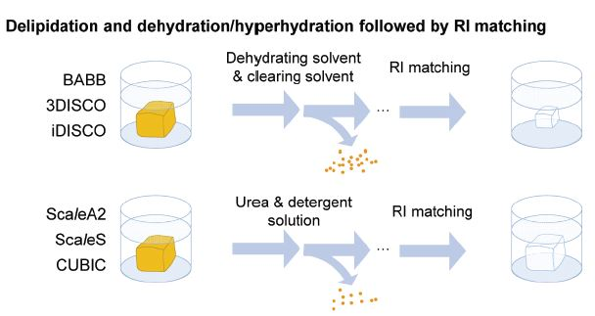
Optical Clearing Techniques
Solvent based
2.
Lipids major source of light scattering
easy implementation
strong clearing capability
Seo J., Choe M., Kim S.Y.. Mol. Cells 39 (6) (2016)
Notes:
Lipids high RI/tendency to from granular structures -> delipidation: to achieve optical homogeneity and transparency
Solvent based: better clearing capability and faster than simple immersion
Rapidly quench FPs and cause tissue shrinkage
Aqueous based solutions containing non-ionic detergents (Triton x-100) -> remove lipids and denaturants –> partially denatures endogenous proteins
„harsch clearing“ -> native biomolecules and their contextual information can be lost

Slide 31
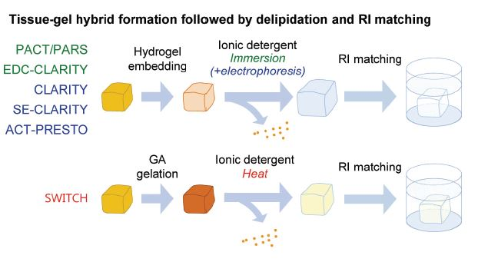
Optical Clearing Techniques
Hydrogel-based
3.
hydrogel is well-preserving structures
Seo J., Choe M., Kim S.Y.. Mol. Cells 39 (6) (2016)
Notes:
extensive delipidation using SDS passive or active (electrophoresis)
Gel network provides support well preserving structures linked to the hydrogel

